Slide 1
Fuzzy Clustering
Subhadip Basu

Slide 2
Fuzzy Sets and Membership Functions
You are approaching a red light and must advise a driving student when to apply the brakes. What would you say:
“Begin braking 74 feet from the crosswalk”?
“Apply the brakes pretty soon”?
Everyday language is one example of the ways vagueness is used and propagated.
Imprecision in data and information gathered from and about our environment is either statistical (e.g., the outcome of a coin toss is a matter of chance) or nonstatistical (e.g., “apply the brakes pretty soon”).
This latter type of uncertainty is called fuzziness.

Slide 3
Fuzzy Sets and Membership Functions
We all assimilate and use fuzzy data, vague rules, and imprecise information.
Accordingly, computational models of real systems should also be able to recognize, represent, manipulate, interpret, and use both fuzzy and statistical uncertainties.
Statistical models deal with random events and outcomes; fuzzy models attempt to capture and quantify nonrandom imprecision.

Slide 4
Fuzzy Sets and Membership Functions
Conventional (or crisp) sets contain objects that satisfy precise properties required for membership. For example, the set of numbers H from 6 to 8 is crisp:
H = {r ∈ ℛ | 6 ≤ r ≤ 8}
m_{H} = 1; 6 ≤ r ≤ 8;
m_{H} = 0; otherwise (m_{H} is a membership function)
Crisp sets correspond to 2-valued logic:
is or isn’t
on or off
black or white
1 or 0

Slide 5
Fuzzy Sets and Membership Functions
Fuzzy sets contain objects that satisfy imprecise properties to varying degrees, for example, the “set” of numbers F that are “close to 7.”
In the case of fuzzy sets, the membership function, m_{F}(r), maps numbers into the entire unit interval [0,1]. The value m_{F}(r) is called the grade of membership of r in F.
Fuzzy sets correspond to continuously-valued logic:
all shades of gray between black (= 1) and white (= 0)

Slide 6
Fuzzy Sets and Membership Functions
Because the property “close to 7” is fuzzy, there is not a unique membership function for F. Rather, it is left to the modeler to decide, based on the potential application and properties desired for F, what m_{F}(r) should be like.
The membership function is the basic idea in fuzzy set theory; its values measure degrees to which objects satisfy imprecisely defined properties.
Fuzzy memberships represent similarities of objects to imprecisely defined properties.
Membership values determine how much fuzziness a fuzzy set contains.

Slide 7
Clustering: revisited
Clustering is a mathematical tool that
attempts to discover structures or
certain patterns in a data set, where
the objects inside each cluster show
a certain degree of similarity.

Slide 8
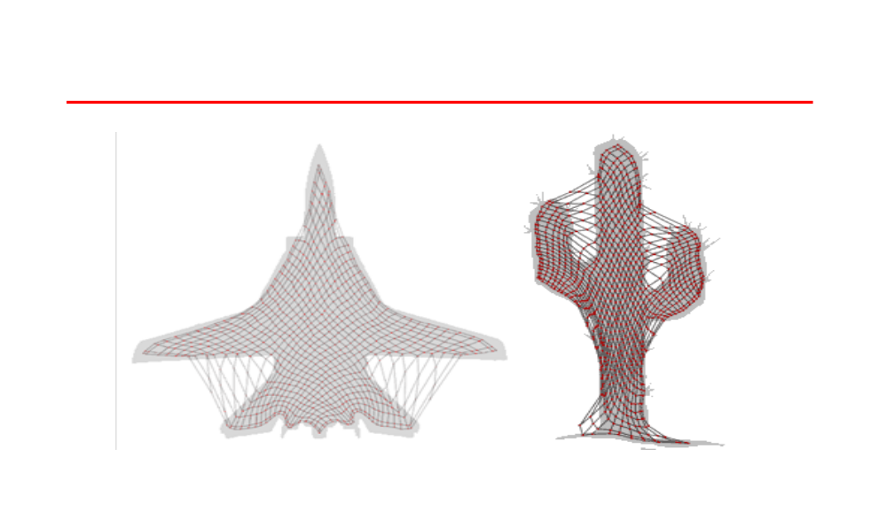
Hard clustering assign each feature
vector to one and only one of the
clusters with a degree of membership
equal to one and well defined
boundaries between clusters.

Slide 9
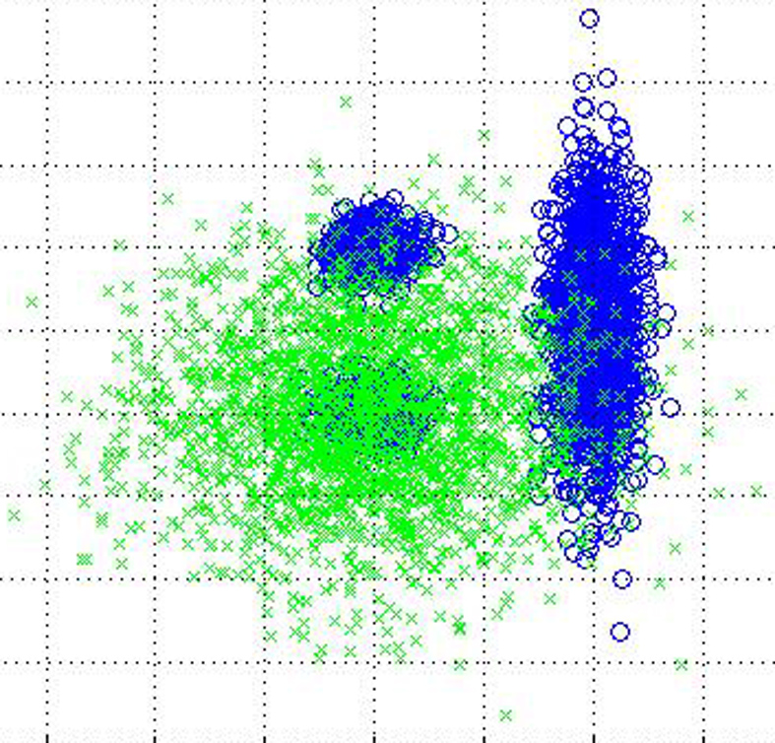
Fuzzy clustering allows each feature
vector to belong to more than one
cluster with different membership
degrees (between 0 and 1) and
vague or fuzzy boundaries between
clusters.

Slide 10
Fuzzy C-means Clustering
Fuzzy c-means (FCM) is a method of clustering which allows one piece of data to belong to two or more clusters.
This method (developed by Dunn in 1973 and improved by Bezdek in 1981) is frequently used in pattern recognition.

Slide 11
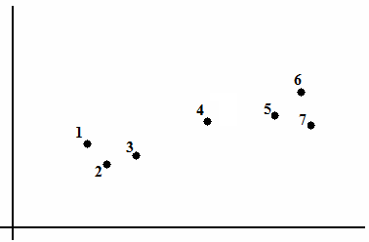
Fuzzy C-means Clustering

Slide 12
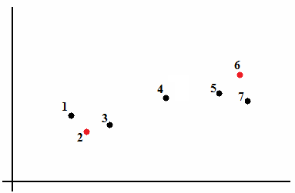
Fuzzy C-means Clustering

Slide 13
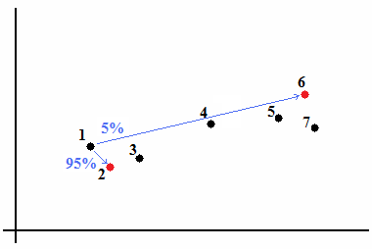
Fuzzy C-means Clustering

Slide 14
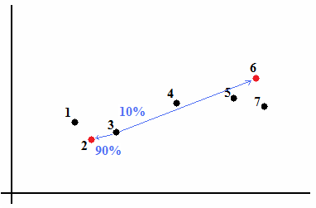
Fuzzy C-means Clustering

Slide 15
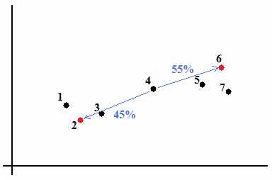
Fuzzy C-means Clustering

Slide 16
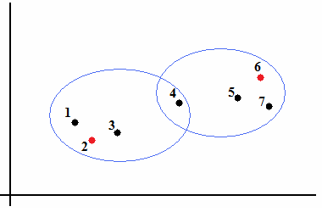
Fuzzy C-means Clustering

Slide 17
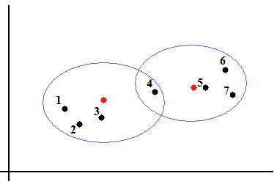
Fuzzy C-means Clustering

Slide 18
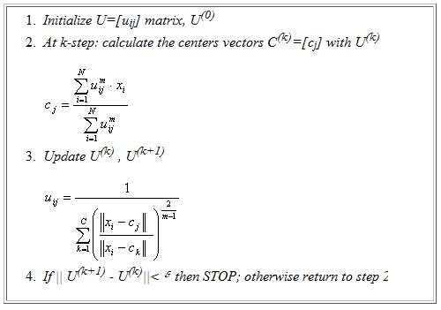
Fuzzy C-means Clustering

Slide 19
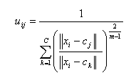

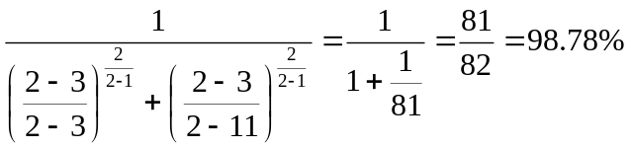
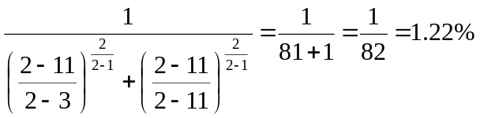
Fuzzy C-means Clustering
For example: we have initial centroid 3 & 11
(with m=2)
For node 2 (1st element):
U11 =
The membership of first node to first cluster
U12 =
The membership of first node to second cluster

Slide 20
Fuzzy C-means Clustering
For example: we have initial centroid 3 & 11
(with m=2)
For node 3 (2nd element):
U21 = 100%
The membership of second node to first cluster
U22 = 0%
The membership of second node to second cluster

Slide 21
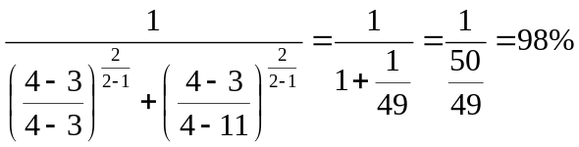
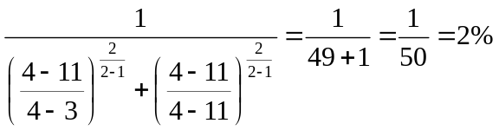
Fuzzy C-means Clustering
For example: we have initial centroid 3 & 11
(with m=2)
For node 4 (3rd element):
U31 =
The membership of first node to first cluster
U32 =
The membership of first node to second cluster

Slide 22
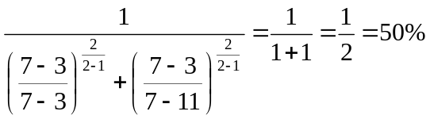
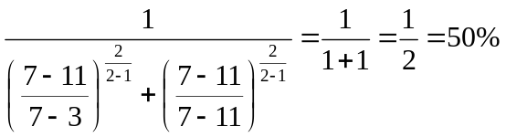
Fuzzy C-means Clustering
For example: we have initial centroid 3 & 11
(with m=2)
For node 7 (4th element):
U41 =
The membership of fourth node to first cluster
U42 =
The membership of fourth node to second cluster

Slide 23
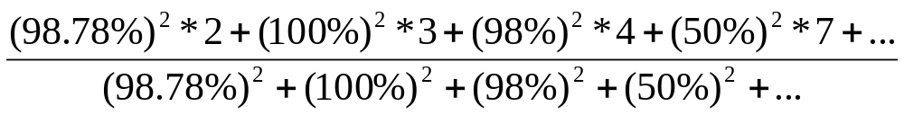

Fuzzy C-means Clustering
C1=

Slide 24
Fuzzy c-means
Pros:
  Allows a data point to be in multiple clusters
  A more natural representation of the behavior of genes
    genes usually are involved in multiple functions
Cons:
  Need to define c, the number of clusters
  Need to determine membership cutoff value
  Clusters are sensitive to initial assignment of centroids
    Fuzzy c-means is not a deterministic algorithm

